Slide 1
Kidney Segmentation in 3D CT Scans
李帅霖

Slide 2
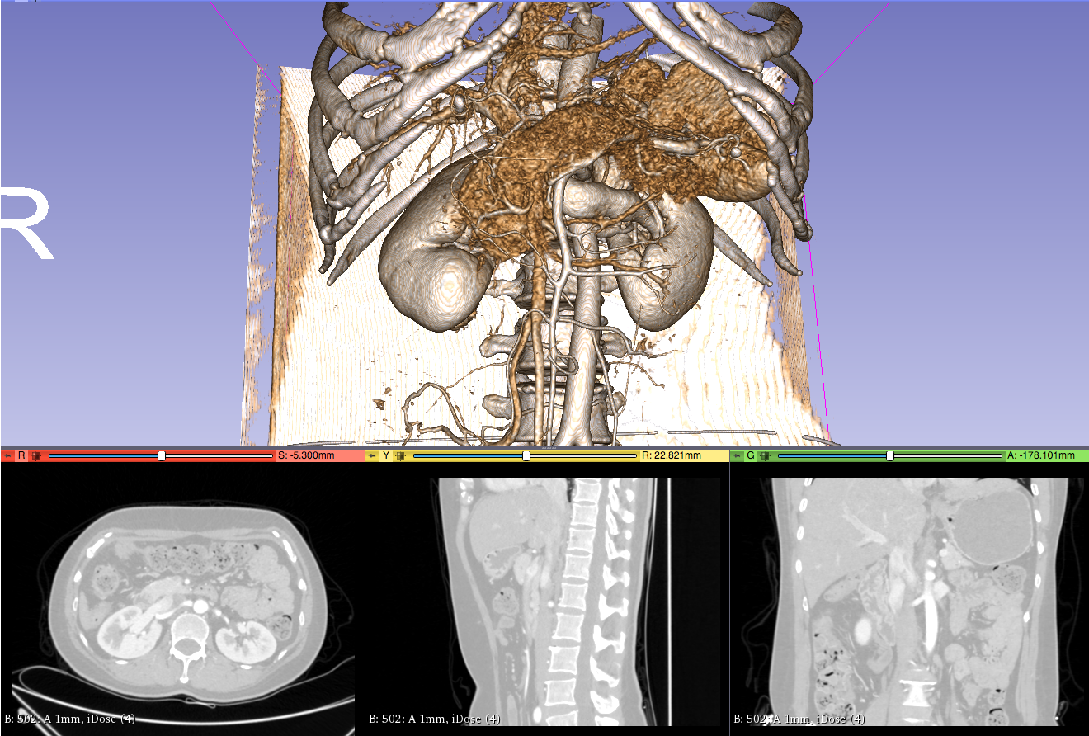
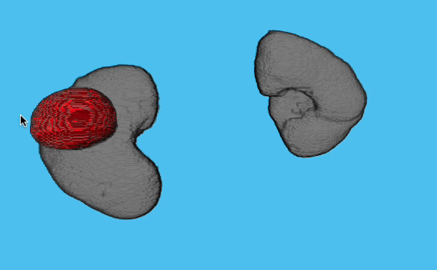
Task
+ Extract kidney from given abdomen CT scans.
Input: an abdomen volume
Output: 3D kidney segmentation

Slide 3
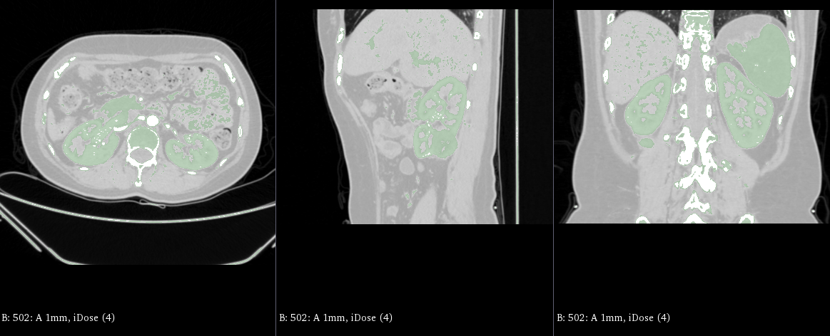
Prior Knowledge
+ Intensity range of kidneys are unique, such as (100, 300).
+ Location of kidneys should be provided.
Fig.1 Three view of CT scans, where intensity of colored regions are from 100 to 300.

Slide 4
Methodology
Determine Region of Interest (ROI)
Obtain foreground and background using threshold method
Morphological operations on foreground and background
Graphcut method
Smoothing operation

Slide 5
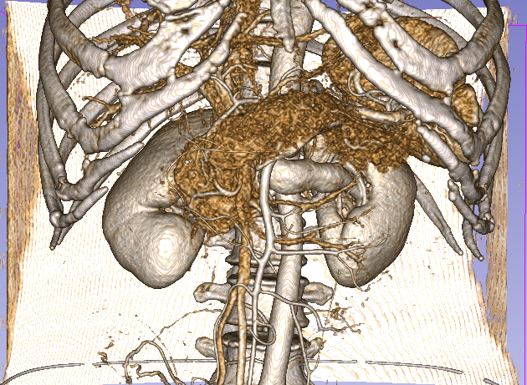
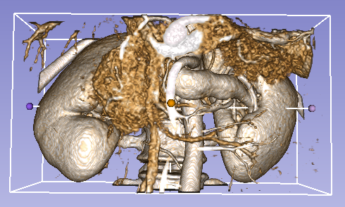
Hand-craft ROI

Slide 6
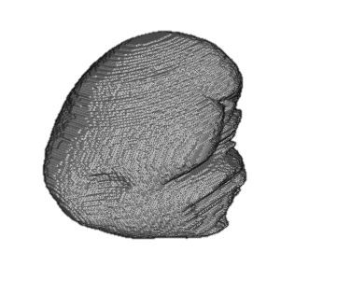
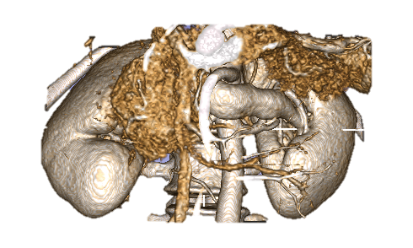
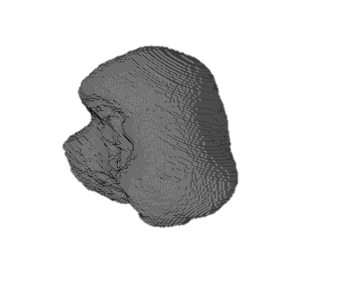
Graphcut Method
+ Foreground: region with pre-defined intensity range.
+ Background: region with pre-defined range.
+ Remove noise: erosion -> largest component
+ Post-process: dilation or graphcut
Superpixels

Slide 7
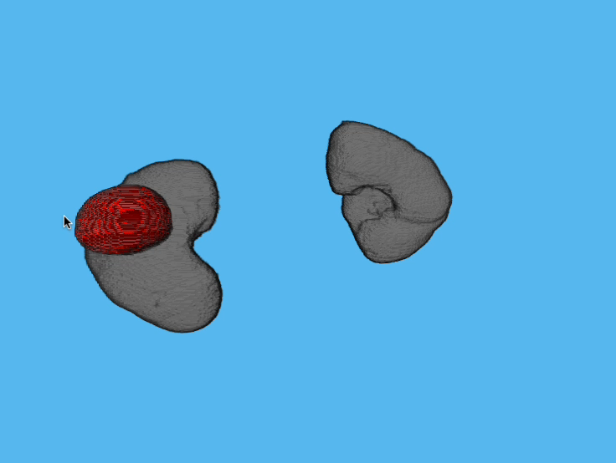
Combination

Slide 8
Conclusion
3D segmentation with graphcut method. (computation expensive)
Prior knowledge is of crucial importance in such a task.
Many tricks are employed to denoise and smoothing, e.g. erosion, close operation and largest components.

